Slide 1
Lecture 11: public policies
SC22o5: Sociology of the family

Slide 2
Where we have been…
Introduction to sociology of the family
Family as a social construct
Normal family ideology
Conceptual frameworks in the analysis of the family
Family Formation, Transitions, and Dissolution
Romantic love and courtship
Marriage and cohabitation
Gender and the division of labor
Entering parenthood
Divorce

Slide 3
Where we are going…
The Family in Context
Transnational Families
Public Policies (Today)

Slide 4
In this lecture…
Government and politics
The reason for the emergence of the institution of government
The purpose and functions of government
The significance of biopower in the implementation of political control
Creation of the Singapore family
Housing
Caregiving

Slide 5
Government and politics

Slide 6
Emergence of The institutions of economy and government
Social institutions revolve around important human needs
In small groups, these needs are satisfied simply and without much conflict
When small groups of individuals become hundreds, matters become more complex
A process must be instituted for making important decisions for the benefit of the group
This process consists of organizational patterns of behavior that eventually crystallize into the institutions of the economy and government
These patterns and their organization are shaped and reinforced by the ideologies prevalent in each society

Slide 7
Institutions of Economy and government
Economy
Who gets what of a society’s rewards and why
Government
Implementation of economic decisions and all decisions that affect society

Slide 8
State, government, and politics
State
The formal representation of government
The functions of the state are carried out by the government
Government
The institution that develops as a consequence of the need to maintain social order in a society
Provides political control through its political processes, the laws it establishes and implements, and the work of its agencies
Politics
The process by which some individuals or groups acquire and maintain power
Notes:
Do not confuse the state and the government
State is abstract, state is always constant and thus government is the one that is changing.

Slide 9
The purpose of government
Societies need government because a group way of life requires a certain degree of social order
In small societies, the family institution is sufficient to maintain social control over its members by exercising moral control
Moral control
Cultural learning
Lies within the individual, having been internalized through socialization

Slide 10
The purpose of government
When societies grow large and complex, other institutions must take over some of the functions of maintaining social order by exercising social control
In large, complex societies, moral and social control must be supplemented by political control
Social control
The process by which a group encourages or compels the individual to behave in a designated way by enforcing folkways and mores
Political control
Social control exerted by forces outside the individual, such as laws and agencies in charge of punishing those who violate laws

Slide 11
The functions of government
Implement political control
Protect citizens from external threats
Plan and maintain facilities and activities that involve large portions of the population
These functions are manifest or deliberate
How about the latent or unintended functions of government?
Notes:
Manifest: deliberate functions of the government, providence of public goods
Latent: unintended functions of the government

Slide 12
Biopower and docile bodies
“But the body is also directly involved in a political field; power relations have an immediate hold upon it; they invest it, mark it, train it, torture it, force it to carry out tasks, to perform ceremonies, to emit signs. This political investment of the body is bound up, in accordance with complex reciprocal relations, with its economic use; it is largely as a force of production that the body is invested with relations of power and domination; but on the other hand, its constitution as labor power is possible only if it is caught up in a system of subjection… the body becomes a useful force only if it is both a productive body and a subjected body” (Foucault 1979, pp. 25-26)

Slide 13
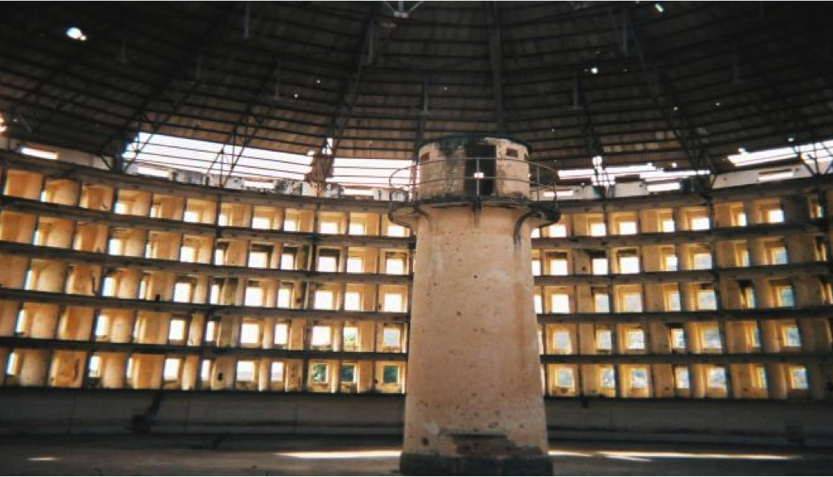
Biopower and docile bodies
The Panopticon Design
Notes:
Design of prison: perfect surveillance machine. Prisoners are constantly in view of the guard tower but never know if they are specifically monitered by the guard tower. They become docile and regulate their own behavior.

Slide 14
Biopower and docile bodies
Disciplinary technologies
Aim to produce a human being who would behave as a docile, yet productive, body

Slide 15
Biopower and docile bodies
Biopower emerged as a mechanism for exercising power in seventeenth century Europe
The fostering of life and the growth and care of populations
The establishment of disciplines such as anatomy, biology, demography, geography, history, etc.

Slide 16
Biopower and docile bodies
Governments and their agencies needed information that was concrete, specific, and measurable
The human species increasingly became the object of political attention through scientific surveillance in a consistent and sustained fashion
The surveillance of the population developed through many institutions
The establishment of this modern form of power is exercised at the micro-level of the body through self-discipline
Notes:
Self discipline instead of top-down approach.

Slide 17
Biopower and docile bodies
The latent or unintended function of the government is to regulate families through the production of docile bodies
Since the family is so central to our lives, it is not surprising that we have created policies to support and protect it
The policies governing marriage and family life serve to promote a particular type of family seen by most individuals as valuable to the way we live

Slide 18
Creation of the Singapore family

Slide 19
Creation of the Singapore family
In Singapore, the family has come to take on very specific definitions in Singapore
The couple formed through heterosexual marriage, where both man and woman are employed in the formal labor market and where the couple has older parents and young children to support
This type of familial membership is explicit criterion for accessing housing and support for caregiving
Notes:
Government has articulated very specific forms of family, and family must take care of itself.

Slide 20
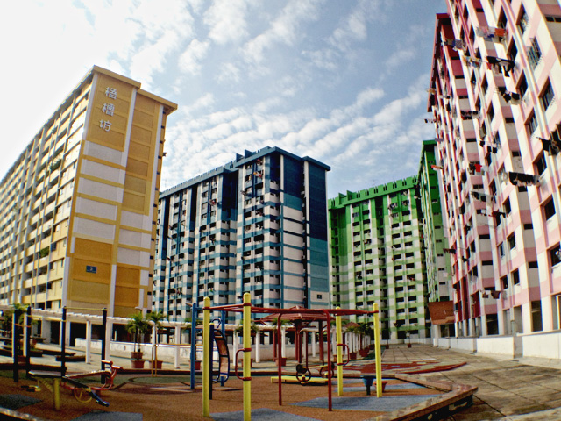
The “normal” path to acquiring a home
Over 80 percent of Singaporeans live in public flats
Although public, individuals own their public flats as private property
The building of public flats is funded by the state, and first-time buyers receive grants enabling them to buy the flats at lower prices
Ownership rests on family formation through marriage and sufficient income

Slide 21
The “normal” path to acquiring a home
Citizens are required by the Housing and Development Board (HDB) to form a family nucleus with other individuals
This criterion is most straightforwardly met when two individuals marry
When a couple divorces, they have to sell their flat and divide the assets
Unmarried Singaporeans cannot buy flats until after the age of 35
Consequently, Singaporeans understand marriage to be a key precondition of living independently from one’s natal family

Slide 22
The “normal” path to acquiring a home
Access to public housing in Singapore is further shaped by the Central Provident Fund (CPF)
The CPF began in 1955 as a form of retirement savings plan
A percentage of a citizen’s wages is placed into her/his CPF account, with mandatory matching contributions by her/his employer
Individuals can use their CPF funds to purchase residential properties
Notes:
No redistribution effect. Individual based

Slide 23
The “normal” path to acquiring a home
Most Singaporeans pay for public housing through CPF
Long-term and continual employment is key to being able to afford housing using one’s CPF savings and necessary for paying the mortgage for up to thirty years
As housing prices increase, it has also become increasingly necessary for people to draw on two incomes in order to fund this purchase
Consequently, a specific heterosexual, economically productive family is enshrined as standard behavior to access housing

Slide 24

The “normal” path to acquiring a home
Singaporeans have developed narratives to describe this process as well as strategies that are shared collectively
Working for 3-4 years to accumulate CPF funds for downpayments
Queuing up under the Fiancé/Fiancée Scheme for a flat
Timing the ROM so that they can collect the keys once they are assigned a flat
Planning a customary wedding so that they can legitimately move in after doing the necessary home renovations

Slide 25
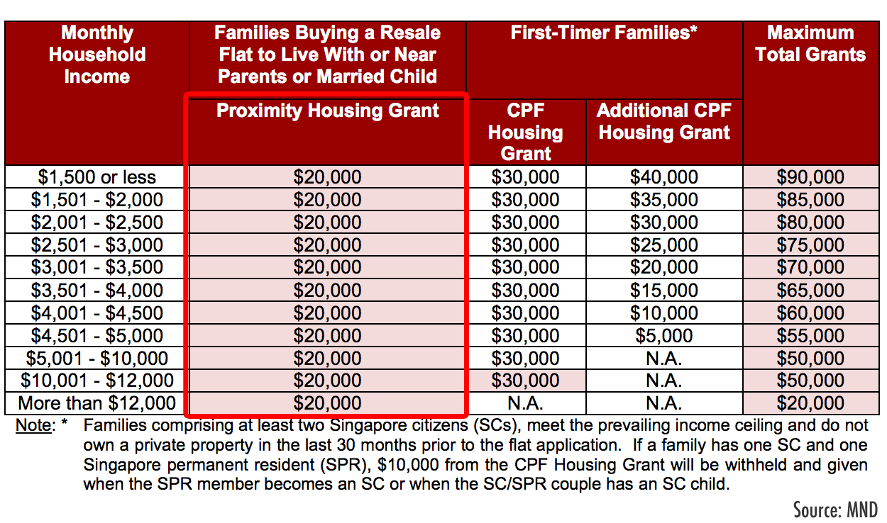
The “normal” path to acquiring a home
Singaporeans’ reasons for choosing certain locations over others
Centered on plans for having children and the necessity of living close to parents and parents-in-law so that they could provide childcare
Potential grandparents were themselves getting older so it would be good to be near them in case anything happens

Slide 26
The “normal” path to acquiring a home
This familiarity with procedures, as well as the integration of structural and cultural elements, are signficant in that housing policies have put in place typical ways of family formation
In the realm of housing, the government has created norms and ideals around the Singaporean family
The effects of public policies also act as strong disciplinary mechanisms

Slide 27
Gendered childcare
European Union
Singapore
Caregiving support is moving towards gender egalitarianism
Policies support working mothers and fathers in their dual roles as workers and parents
Support is child-centered and individualized
Caregiving support reinforces narrow familial norms
Schemes are designed primarily for the heterosexual married couple
All women are reified as responsible for care work

Slide 28
Gendered childcare
In recent decades, women have acquired parity in education and are increasingly entering the formal workforce
However, public policies toward parents of young children reinforce women’s responsibilities as choice-bearers and decision-makers of matters pertaining to children and the household
Narrow familial norms are reinforced as dual-income married heterosexual couples at receive most public support

Slide 29
Gendered childcare
Paid maternity leave for working married women has been increasing over the years, but for a long time, the law did not require employers to give paternity leave
Married women in the civil service have access to lengthy unpaid leave (up to four years) for childcare, but their male counterparts do not have access to this option
To benefit from the full sixteen weeks of paid maternity leave, mothers have to be legally married to their children’s fathers

Slide 30
Gendered childcare
Family is the first line of support
Caregiving as a private problem with private solutions
Introduction of schemes (for example, Baby Bonus; maternity leave; income tax reliefs/rebates) targeted at individual families and come with restrictive criteria
Families must finance care themselves as the childcare/preschool sector is market-driven and there is no guaranteed access

Slide 31
Gendered childcare
Maintaining caregiving within the home
The Foreign Maid Scheme allows a large influx of women to work in Singapore as migrant domestic workers
Migrant domestic workers are required to live with their employers and treated as a special category of workers whose labor has no limits
Many middle-to-high-income Singaporeans end up using this is the form of help to care of both young and old

Slide 32
Gendered childcare
The presence of migrant domestic workers within the middle-class reinforces this childcare norm
Take sixteen weeks maternity leave and assume that a grandmother will take on day-to-day responsibility for one’s child
Figure out if
The child will live with her/his parents full-time
He/she will live with the grandparent(s) on weekdays and go home on weekends
He/she will be at the grandparent(s)’ during the day and be ferried home at night
Because grandmothers are getting older, couples have no choice but to hire maids
The large and normalized presence of migrant domestic workers has classed, gendered, and ethnicized implications
Maids are seen as having different values and cannot be trusted
They are hired to help out while grandmothers/parents supervise

Slide 33
Gendered childcare
Caregiving naturalized as women’s work
“Maid levy relief’’ for married working mothers
Women who must find other women to replace themselves
Having a maid is a norm more accessible to those with the economic means to hire domestic workers and support grandmother caregivers
This form of caregiving support reproduces the heterosexual, married, dual-income couple as the familial norm
Notes:
Seen as a norm, but only available for people with the sufficient financial support.

Slide 34
summary
Biopower is the institutional control of the body in the modern state through methods of categorization, measurement, definition, and validation
Biopower includes practices in all institutionalized areas of life that generate specific kinds of knowledge about the body and produce specific kinds of bodies
Biopower is evident in that rules create practices that generate cultural scripts regarding normal Singaporean ways of acquiring housing and arranging for childcare

